Slide 1
Introduction (Chapters 1 & 2)
Dr. Shengquan Wang
Most slides are adopted from
Artificial Intelligence: A Modern Approach, 3rd ed. by Stuart Russell (UC Berkeley) and Peter Norvig (Google).
Peter Norvig and Sebastian Thrun for Intro to Artificial Intelligence at Udacity.
Dan Klein and Pieter Abbeel for CS188 Intro to AI at UC Berkeley.

Slide 2
Quiz
AI has successfully been used in
Finance
Robotics
Games
Medicine
The Web

Slide 3

AI in Finance
Rates
News
Stock Market
Bonds
Commodities
Trading Agent
Trading decisions
Trades

Slide 4

AI in Robotics
Cameras
Microphones
Touch
Environment
Motors
Voice

Slide 5
AI in Games
You
Game Agent
Your move
decisions
Its move

Slide 6
AI in Medicine
Diagnostic Agent
Vital signals
Diagnostics

Slide 7


AI in The Web
WWW
Crawler Agent
Web pages
DB
Query
Result

Slide 8
Outline
Intelligent Agent

Slide 9

An Intelligent Agent
Through many percepts/actions cycles
Program: control policy of the agent

Slide 10
Agent Types
Four basic types in order of increasing generality:
Simple reflex agents
Model-based reflex agents
Goal-based agents
Utility-based agents

Slide 11
Simple Reflex Agents
Reflex agents: Choose action based on current percept, ignoring the rest of the percept history.
Taxi driver: If car-in-front-is-braking then initiate-braking
Human analogy: The eye blinks when something approaches it.
Pros: Simple
Cons: limited intelligence
It will work only if the environment is fully observable.
Even a little bit of unobservability can cause serious trouble.
E.g., it is not always possible to tell from a single image whether the car is braking.
Notes:
Examples: blinking your eye (not using your entire thinking capabilities), vacuum cleaner moving towards nearest dirt

Slide 12
Model-based Reflex Agents
The agent should maintain some internal state that depends on the percept history.
E.g., changing lanes: the agent needs to keep track of where the other cars are if it can’t see them all at once.
Two kinds of knowledge are required:
How does the world evolve?
How does the agent’s action affect the world?

Slide 13
Goal-based Agents
Knowing something about the current state of the environment is not always enough to decide what to do.
The agent needs some sort of goal information that describes situations that are desirable
E.g., the passenger’s destination.

Slide 14
Utility-based Agents
Goals alone are not enough to generate high-quality behavior in most environments.
Goals just provide a crude binary distinction between “happy” and “unhappy” states.
A fine-grained agent’s utility function is more desirable.

Slide 15
Outline
Intelligent Agent
Task Environment

Slide 16
Task Environment: PEAS
Performance measure
Environment
Actuators
Sensors

Slide 17
PEAS: Taxi Driver
Performance Measure | safe, fast, legal, comfortable trip, maximize profits
Environment | roads, other traffic, pedestrians, customers
Actuators | steering, accelerator, brake, signal, horn, display
Sensors | cameras, sonar, speedometer, GPS, odometer, accelerometer, engine sensors, keyboard

Slide 18
PEAS: Refinery Controller
Performance Measure | purity, yield, safety
Environment | refinery, operators
Actuators | valves, pumps, heaters, displays
Sensors | temperature, pressure, chemical sensors

Slide 19
Properties of Task Environments
Observable | Agent | Next state | State depend. | Changing environ. | State space
Fully | Single | Deterministic | Episodic | Static | Discrete
Partially | Multi | Stochastic | Sequential | Dynamic | Continuous

Slide 20
Examples
Taxi driving | Partially | Multi | Stochastic | Sequential | Dynamic | Continuous
Refinery controller
Partially | Single | Stochastic | Sequential | Dynamic | Continuous
Poker
Partially | Multi | Stochastic | Sequential | Static | Discrete

Slide 21
Environment Representation
The various ways that the components can represent the environment:
Atomic
Factored
Structured

Slide 22
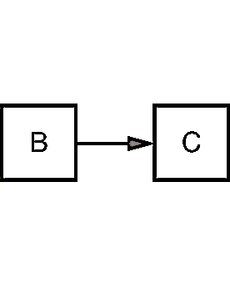
Example: Driving Route (1)
Atomic: the state of world to just the name of the city we are in.

Slide 23
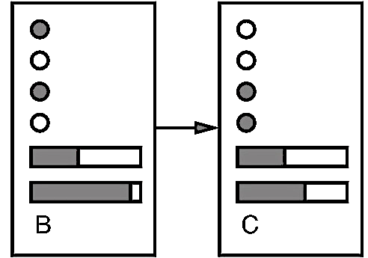
Example: Driving Route (2)
Factored:
how much gas is in the tank?
current GPS coordinates
whether or not the oil warning light is working?
how much spare change we have for toll crossings?
what station is on the radio?
…

Slide 24
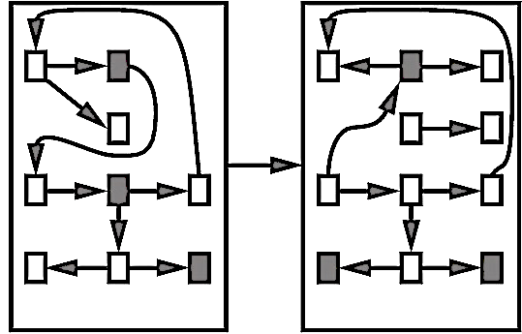
Example: Driving Route (3)
Structured: a large truck ahead of us is reversing into the driveway of a dairy farm but a cow has got loose and is blocking the truck’s path.

